Slide 1

CPQ – Asia Connectivity Check Design and Mock Up Dec ‘19
Colt confidential

Slide 2

Document Release and Change Log Details
CPQ Asia
Version Number | 0.2
Date | 02nd Dec, 2019
Change log | ULL Connectivity Check Override functionality

Slide 3
CPQ Asia: Connectivity Check : Asia
Japan , Singapore and Hong Kong supports ULL Fibre
ULL Fibre availability is provided by our preferred carrier to the Colt
CPQ will provide an option to check the ULL Fibre connectivity for these countries

Slide 4
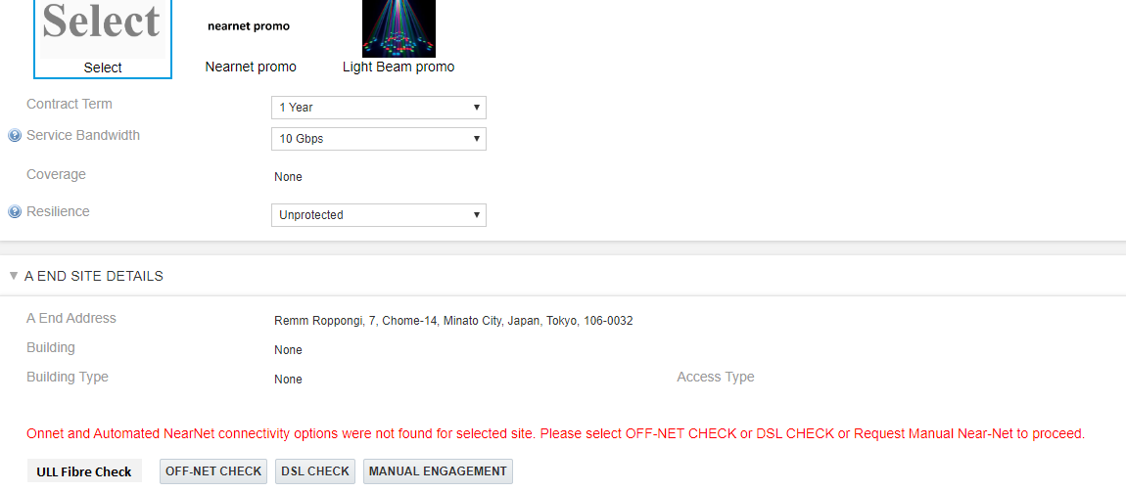
CPQ Asia: Connectivity Check : Japan
On the Site Detail page, there will be another option called ‘ULL Fibre Check’ which will be introduced.
ULL Fibre check will work only for Japan, Singapore and Hong Kong. For Other countries it would return a error message
This change is required across Ethernet Line, Ethernet Hub & Spoke, Wave & IPAccess

Slide 5
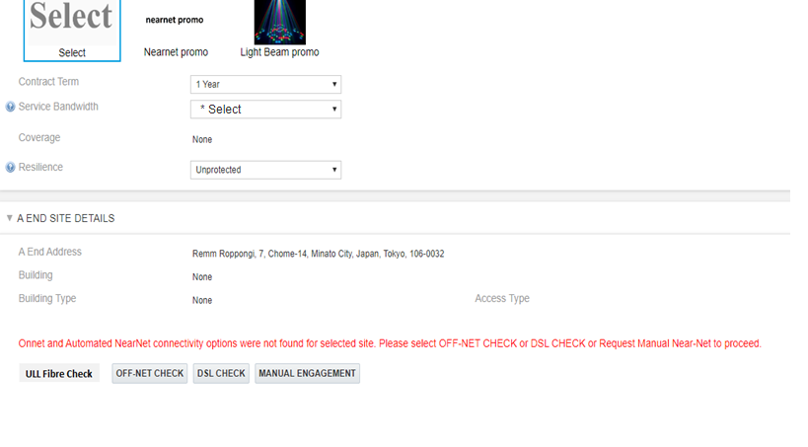
CPQ Asia: Connectivity Check : Japan
Only for Japan , when user clicks on the ‘ULL Fibre’ check button then system should check ‘Service Bandwidth’ and ‘Resiliency’ field are populated
In case they are missing , CPQ will be provide the necessary error message to select these fields
Please select bandwidth to proceed with the ULL Fibre check

Slide 6
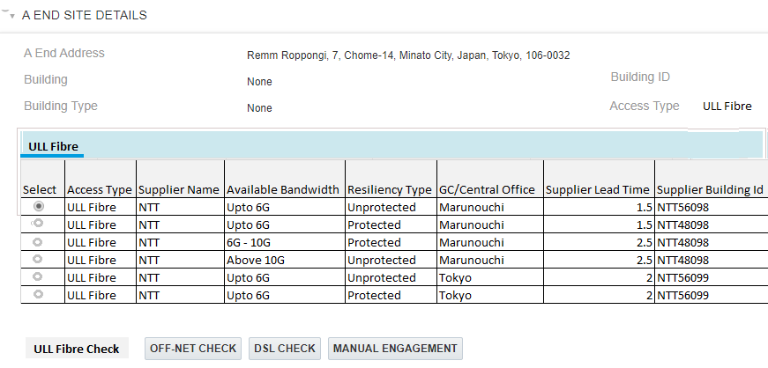
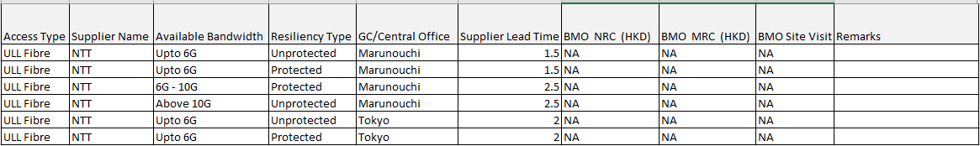
CPQ Asia: Connectivity Check : Japan
CPQ will present the ULL Fibre connectivity details in a tabular form in connectivity table.
CPQ will get the result back from the NTT data set
New Building
NTT5657
Retail Building

Slide 7
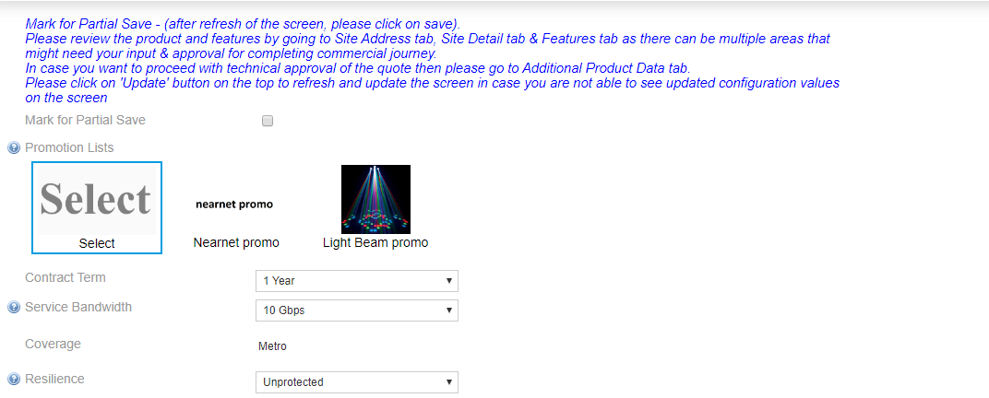
CPQ Asia: Connectivity Check : Japan
Once user selects an ULL Fibre option then the bandwidth and Resiliency will validated against what is present on the quote and appropriate error message will be shown
Bandwidth option selected in the ULL Table does match the Service bandwidth Please change the bandwidth or select another option from ULL table
Resiliency option selected in the ULL Table does match the Resiliency selected Please change the bandwidth or select another option from ULL table

Slide 8
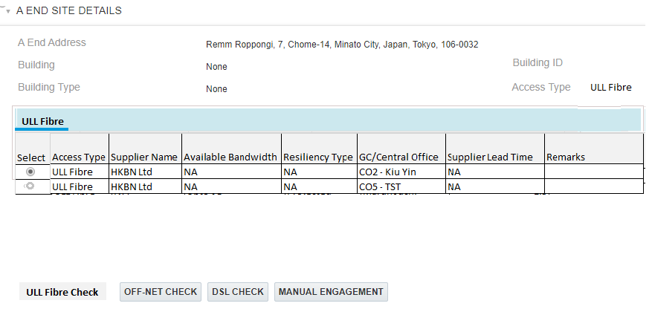
CPQ Asia: Connectivity Check : Hong Kong
CPQ will present the ULL Fibre connectivity details in a tabular form. CPQ will get the result back from the HKBN(Hong Kong) data set
For Hong Kong , system will display BMO charges in the connectivity table. These will not be applied automatically on the quote.
For Hong Kong, in case the building is more than 10 Km from central office. CPQ will automatically identify such building and apply the supplier surcharge
742-748 Cheung Sha Wan Road, Cheung Sha Wan, Hong Kong
New Building
HKBN1245
Retail Building

Slide 9
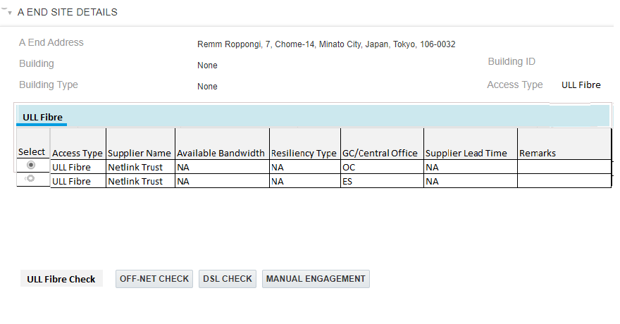
CPQ Asia: Connectivity Check : Singapore
CPQ will present the ULL Fibre connectivity details in a tabular form. CPQ will get the result back from the Netlink Trust data set
1, STRAITS BOULEVARD, CHINESE CULTURAL CENTRE, 018906, Singapore
New Building
NET76768
Retail Building

Slide 10
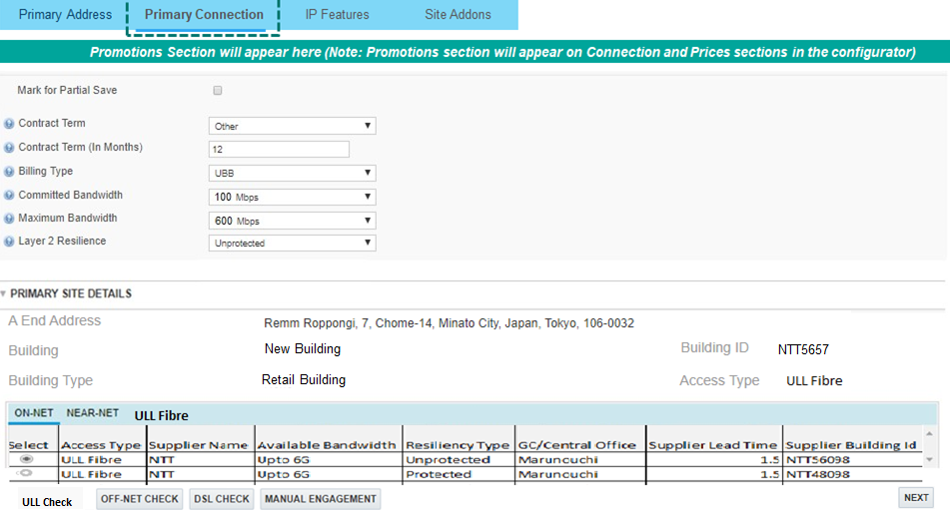
CPQ Asia: Connectivity Check : IPAccess : Japan
For IPAccess ULL fibre options will be available on Primary Connection page and Secondary connection page
Hong Kong and Singapore - ULL Fibre will work same as Ethernet line

Slide 11
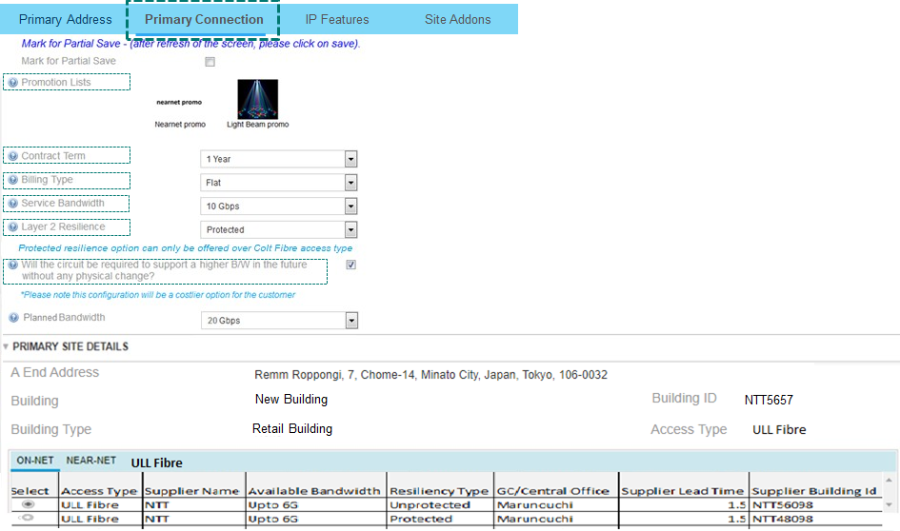
CPQ Asia: Connectivity Check : IPAccess : Japan
Once user selects an ULL Fibre option then the bandwidth and Resiliency will validated against what is present on the quote and appropriate error message will be shown
Scenario1: For IPAccess, if the billing type is Flat then the bandwidth check will be performed on Service Bandwidth
Bandwidth option selected in the ULL Table does match the bandwidth Please change the bandwidth or select another option from ULL table
Resiliency option selected in the ULL Table does match the Resiliency selected Please change the bandwidth or select another option from ULL table

Slide 12
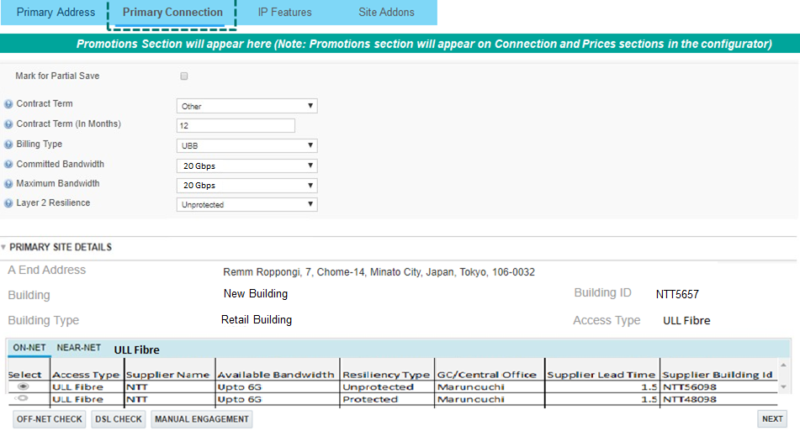
CPQ Asia: Connectivity Check : IPAccess : Japan
Once user selects an ULL Fibre option then the bandwidth and Resiliency will validated against what is present on the quote and appropriate error message will be shown
Scenario2: For IPAccess, if the billing type is UBB then the bandwidth check will be performed on Maximum Bandwidth
Bandwidth option selected in the ULL Table does match the bandwidth Please change the bandwidth or select another option from ULL table
Resiliency option selected in the ULL Table does match the Resiliency selected Please change the bandwidth or select another option from ULL table

Slide 13
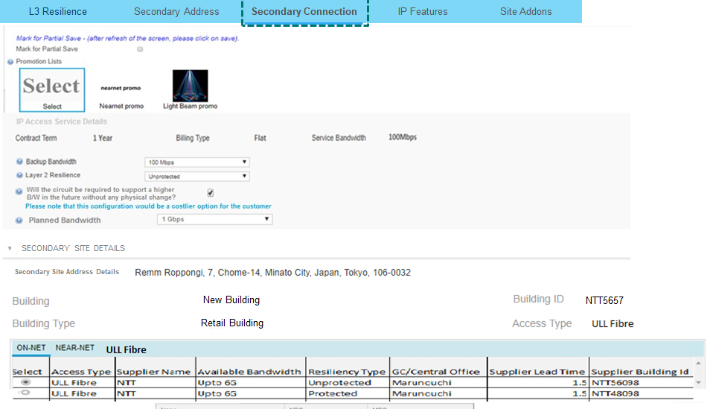
CPQ Asia: Connectivity Check : IPAccess : Japan
Once user selects an ULL Fibre option then the bandwidth and Resiliency will validated against what is present on the quote and appropriate error message will be shown
Scenario3: For IPAccess, for the secondary connection the bandwidth check has to be done against the Backup bandwidth
Bandwidth option selected in the ULL Table does match the bandwidth Please change the bandwidth or select another option from ULL table
Resiliency option selected in the ULL Table does match the Resiliency selected Please change the bandwidth or select another option from ULL table

Slide 14
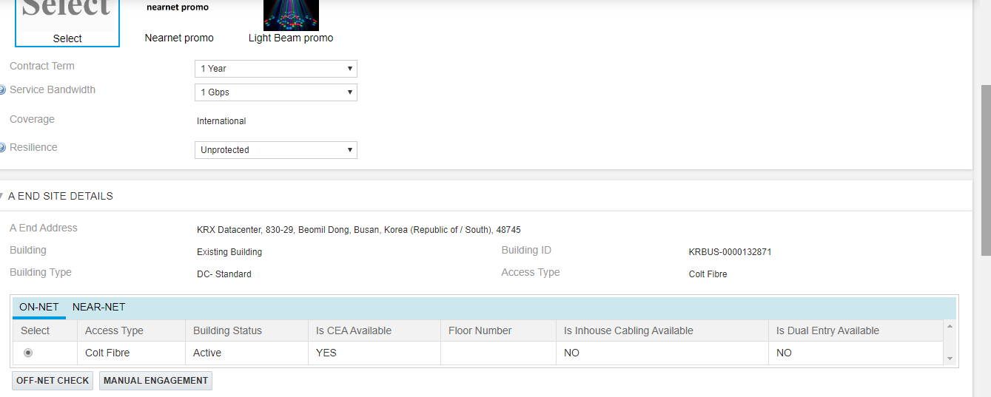

CPQ Asia: Connectivity Check : South Korea
For South Korea, we have a one DC building which provides on-net connectivity
Base price not found message comes in the pricing grid for this DC selection.
CPQ will not provide any additional logic to handle any product specific variation for this DC

Slide 15
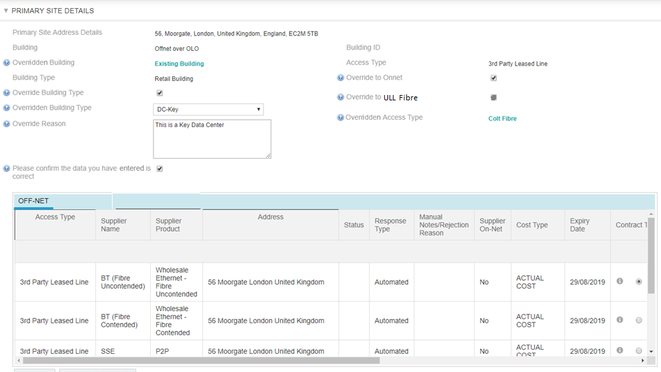
CPQ Asia: Site Override: Onnet
CPQ will have an option to override the connectivity check to Onnet or ULL Fibre.
If the site does not return the connectivity check as Onnet, then user will have an option to override the connectivity to Onnet by clicking on the ‘Override to Onnet’ checkbox. ULL Fibre override option will disabled as user has not done ULL Fibre check.
When the Override to onnet selected , the access type will be updated to “Colt Fibre”
The Overridden Building will be updated to “Existing Building”
Email Notification applicable teams when the override site feature is used by CPQ user
Note: “If the user does not enter the override reason and select the confirmation checkbox, CPQ will display a warning message to the user to enter those details before they can progress further.
For business rules please refer slide ‘Override Site Details – Business Rules’

Slide 16
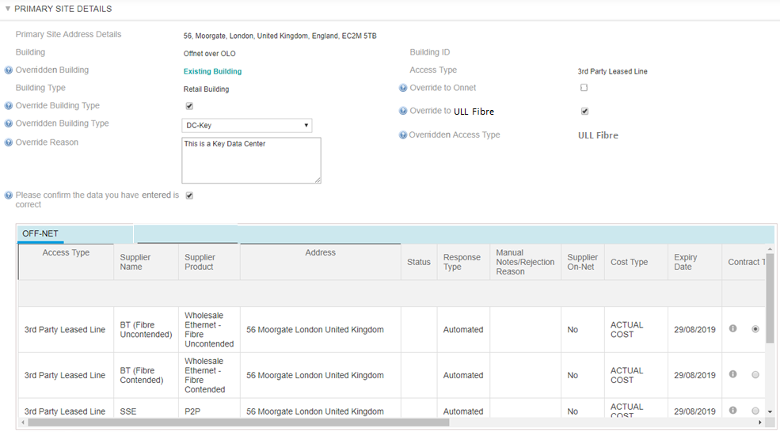
CPQ Asia: Site Override: ULL Fibre
If the site does not return the connectivity check for ULL Fibre, then user will have an option to override the connectivity to ULL Fibre by clicking on the ‘Override to ULL FIbre’ checkbox.
When the Override to ULL Fibre selected , the access type will be updated to “ULL Fibre”
The Overridden Building will be updated to “Existing Building”
Email Notification applicable teams when the override site feature is used by CPQ user
Note: “If the user does not enter the override reason and select the confirmation checkbox, CPQ will display a warning message to the user to enter those details before they can progress further.
For business rules please refer slide ‘Override Site Details – Business Rules’

Slide 17
CPQ Asia: Site Override: Email Notification for the override site feature is used by CPQ user
Email ‘To’ list to be agreed (Group mail id to be confirmed)
Subject: Incorrect Site Details identified for Quote <Quote ID> under Opportunity <Opportunity Name>
Dear Fibre Planning Team,
This is to notify you that the following site:
* Street No.:
* Street Name:
* City:
* Post Code:
* Country:
* Access Type
is showing as Nearnet/Offnet in CPQ after Connectivity Check whereas the Sales has confirmed that this site is an Onnet site. <this line appears if the Override to Onnet feature is used>
The building type for this site is marked as <Original Building type> and sales has confirmed that this building is a <Overridden building type> <This line appears if the Override Building type feature is used>
Reason: <Reason for Override Site Details populated here>
Could you please validate and update the Site and Building status of the above mentioned Site in Premise Master so that the same can reflect in CPQ.
Below mentioned are the Quote details for your reference:
Quote ID: <Quote ID appear here>
Account Name : BNP PARIBAS PARTNERS FOR INNOVATION <account name appears here>
Opportunity Id : 264702 <OCN appear here>
Sales User Name : <User who used the override feature name appear here>
Thanks & Regards
CPQ Support Team

Slide 18
CPQ Asia: Site Override: Business Rules
Component | Details
Product | Override functionality will be enhanced for IPAccess & will be introduced for Ethernet & Wave Gobally
Override Connectivity | User will have option to ‘Override to Onnet’ & ‘Overide to ULL’ Override to Onnet option will be available when connectivity check does not return Onnet. Override to ULL Fibre option will be available when connectivity check does not return ULL Fibre.
Overridden Building | If Overridden Access Type =“Colt Fibre” and Overridden Building = “Existing Building. If Overridden Access Type =“ULL Fibre” and Overridden Building = “Existing Building ‘ (else this field will be hidden)
Override Building Type Checkbox | If this checkbox is selected, the Overridden Building type option will become visible (else it will be hidden)
Overridden Building Type | The user can ONLY override to either of the following option: “Retail Building”, “DC-Key” or “DC-Standard”.
Overridden Access Type | If Override Connectivity= Onnet then Overridden Access Type = “Colt Fibre” . If Override Connectivity= ULL Fibre then Overridden Access Type = “ULL Fibre” (else this field should be hidden)
All overridden data | Important: All overridden data or inputs will be lost if the “Override Connectivity” and “Override Building Type” checkboxes are unchecked or If any other connectivity option is requested. If the user selects a different connectivity option, then the override features will be hidden and the Building, Building type and Access type will be updated basis the connectivity result selected (TBC)
Email flag | Email flag will be hidden always, which will detect if the overridden values have changed, if yes, then an email flag will be true
Email functionality | tbc
Rules the quote cannot be saved to the line item if the following rules are violated. (Mark for Partial Save does not override this).
Override Reason | Cannot be empty (100 character limit) (There will be a error message on clicking Next button if this checkbox is not checked when using the override site details option)
Please confirm that the data you have inputted is correct | Must be checked in order to proceed with Quote Configuration (There will be a error message on clicking Next button if this checkbox is not checked when using the override site details option)
Quote Line Item ID | User | Address | Original Building | Original Building Type | Original Access Type | Overridden Building | Overridden Building Type | Overridden Access Type | Reason for Overriding
1 | John | Site 1 Address | None | None | None | Existing | KEY-DC | Colt Fibre | This is a customer private datacenter
2 | Arun | Site 2 Address | OLO over offnet | Retail Building | 3rd Party Leased line | OLO over offnet | Standard DC | 3rd Party Leased line | Delivery node is a standard DC
Envisioned Reporting Format:

Slide 19
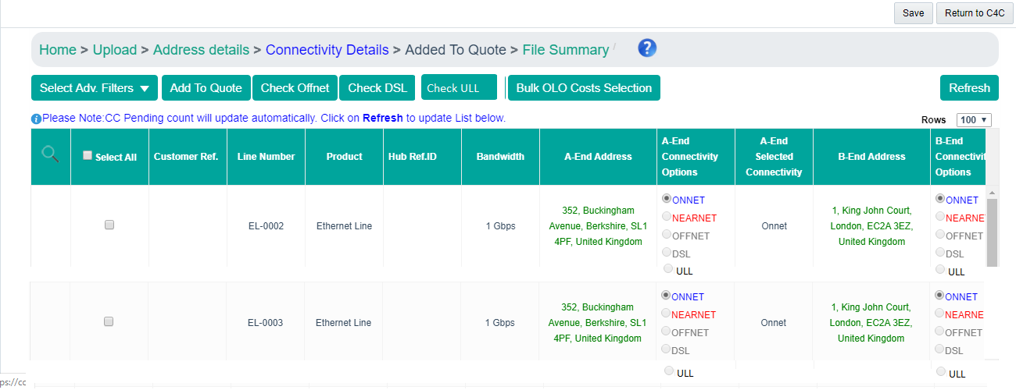
CPQ Asia: Connectivity Check: Bulk
ULL Check button should be introduced to execute the ULL check
No hiding rule is required for this button
For each line item a new radio button for ULL should be provided.
Remm Roppongi, Chome – 7, Minato City, Tokyo 106-0032
Villa Fontanne, Chome – 7, Minato City, Tokyo 106-0032

Slide 20
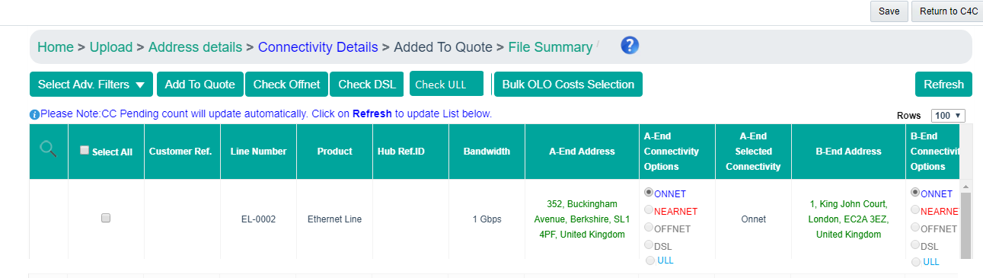
CPQ Asia: Connectivity Check: Bulk
In case the ULL check provides results back then the colour of the text (ULL) should change to blue. This indicates the availability
Remm Roppongi, Chome – 7, Minato City, Tokyo 106-0032
Villa Fontanne, Chome – 7, Minato City, Tokyo 106-0032

Slide 21
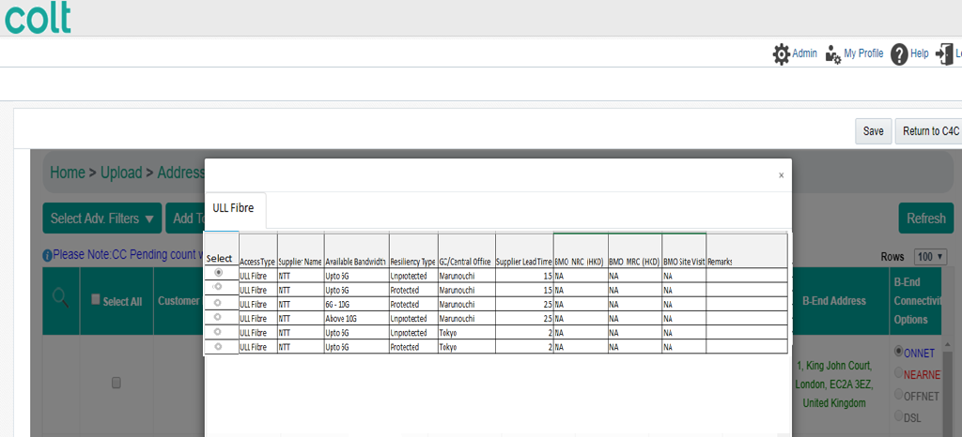
CPQ Asia: Connectivity Check: Bulk
Once user select the ULL Fibre posting running the ULL Fibre check then the records will be displayed to him in pop up (similar to Offnet)

Slide 22
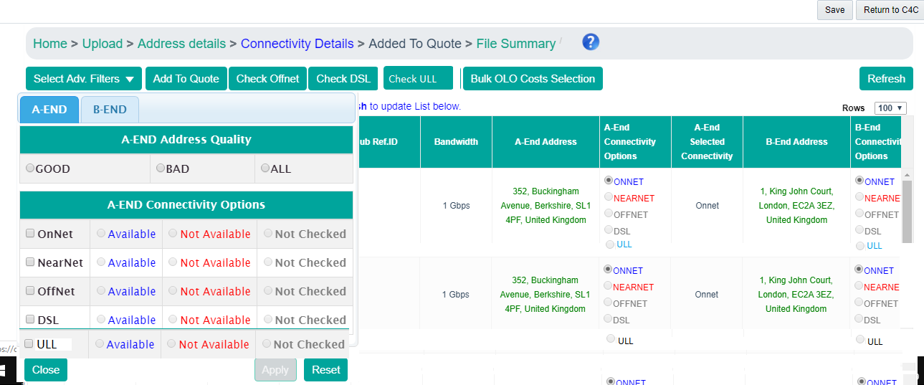
CPQ Asia: Connectivity Check: Bulk
Advance filter section to be updated to have the ULL option to filter out the records

Slide 23
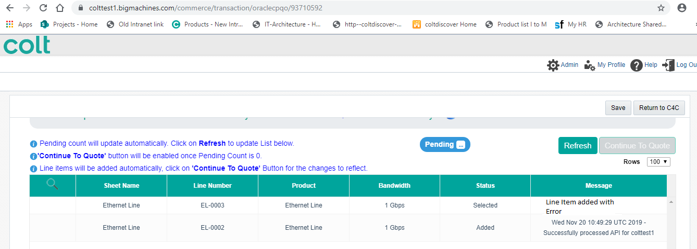
CPQ Asia: Connectivity Check: Bulk
In case the bandwidth and resiliency of the bulk record is not inline with the ULL fibre record selected on the connectivity page then system will show error to the user
User can correct the bandwidth on the CPQ config screen

Slide 25
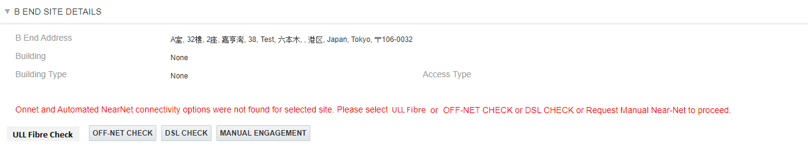
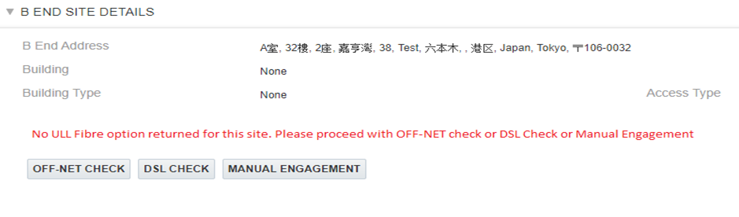
CPQ Asia: Override
User lands on the Site detail page where ULL Fibre hcek option is provide
User clicks on the ULL Fibre option . In case ULL Fibre check fails , system will provide message to the user to go for DSL, Offnet or Manual engagement options

Slide 26
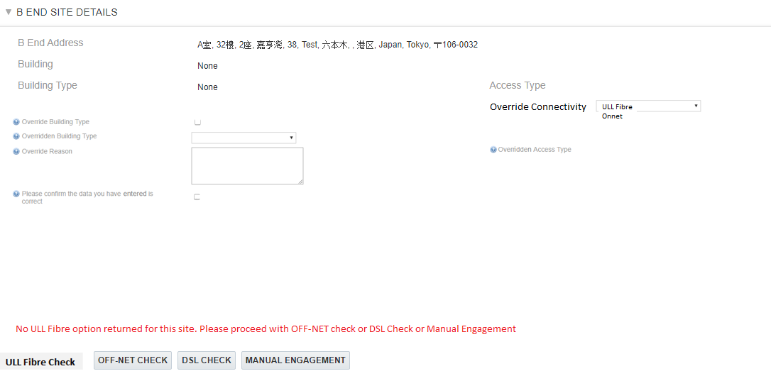
CPQ Asia: Override

Slide 27
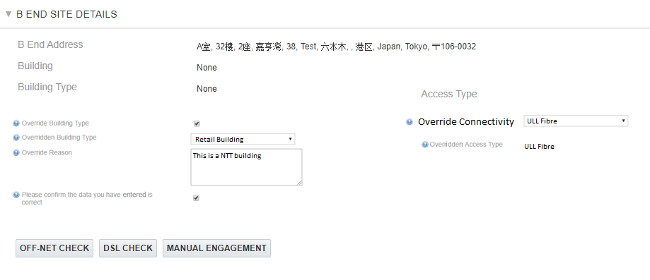

CPQ Asia: Site :Site Override: Ethernet & Wave
CPQ will have an option to override the connectivity check to Onnet or ULL Fibre, if the site is returned as either Nearnet or Offnet.
When the Override Connectivity = ULL Fibre is selected , the access type will be updated to “ULL Fibre”
The Overridden Building will be updated to “Existing Building”
Email Notification applicable teams when the override site feature is used by CPQ user
Note: “If the user does not enter the override reason and select the confirmation checkbox, CPQ will display a warning message to the user to enter those details before they can progress further.
For business rules please refer slide ‘Override Site Details – Business Rules’

Slide 28
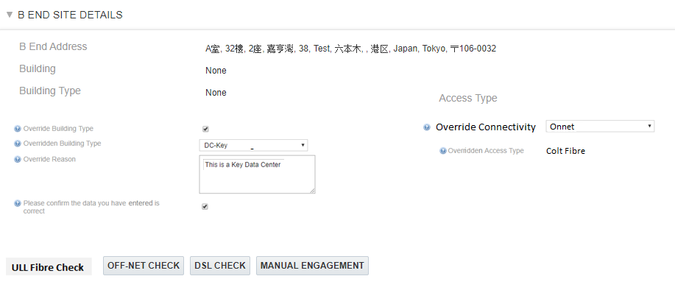
CPQ Asia: Site :Site Override: Ethernet & Wave
CPQ will have an option to override the connectivity check to Onnet or ULL Fibre, if the site is returned as either Nearnet or Offnet.
When the Override Connectivity = Onnet is selected , the access type will be updated to “Colt Fibre
The Overridden Building will be updated to “Existing Building”
Email Notification applicable teams when the override site feature is used by CPQ user
Note: “If the user does not enter the override reason and select the confirmation checkbox, CPQ will display a warning message to the user to enter those details before they can progress further.
For business rules please refer slide ‘Override Site Details – Business Rules’
.

Slide 29
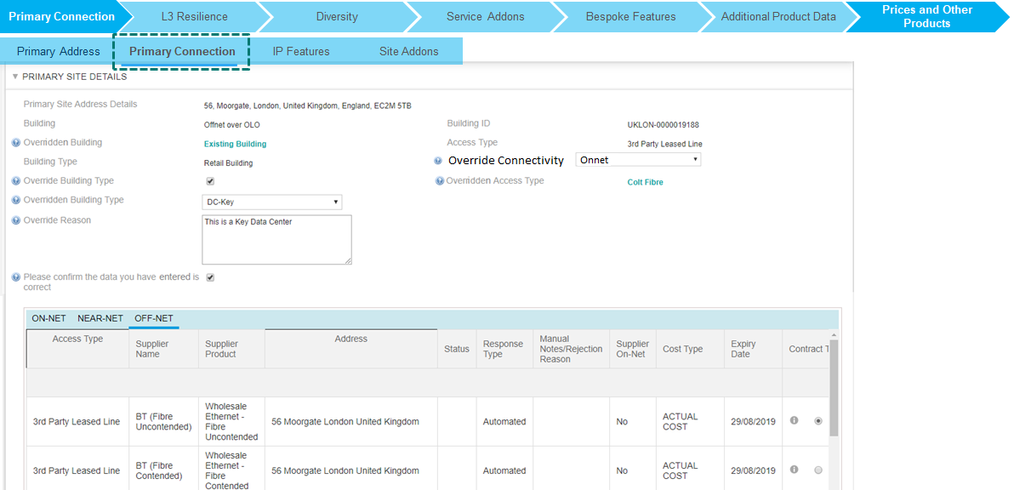
CPQ Asia: Site Override: IPAccess
For IPACcess , the “Override to Onnet’ will be changed to ‘Override Connectivity’ . This attribute will have two value i.e ‘Onnet’ and ‘ULL Fibre’
When the Override Connectivity = Onnet, then access type will be updated to “Colt Fibre”
When the Override Connectivity = ULL Fibre, then access type will be updated to “ULL Fibre
Rest other functionality for IPAccess will remain the same
Email Notification applicable teams when the override site feature is used by CPQ user

